Slide 1



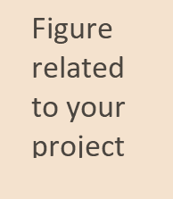
Gateway Institute Of Engineering And Technology
Netflix – Data Analysis
Presented by
Guided by
Gaurav (21010001002)
Mr. Parduman
Submitted for the partial fulfillment
of
B.TECH
in
Computer Science
B.TECH (CSE)

Slide 2
CONTENT
OUTLINE
PROJECT BACKGROUND
DATA SET
METHODS USED
RESULTS
Netflix – Data Analysis
2

Slide 3
1. OUTLINE
About Netflix:
Netflix is the world's leading media streaming platform, operating in nearly every country in the world. It was one of the very first players in the streaming industry when it made the transition in 2007, and the bet has paid off with hundreds of millions of subscribers around the world
Overview:
In this we are going to perform Some exploratory Data analysis to find some hidden trends and pattern in dataset. will going to load and read the data using pandas, do some cleaning and Processing of data and will explore the dataset through visualizations and graphs using matplotlib and seaborn.
Netflix – Data Analysis
3

Slide 4
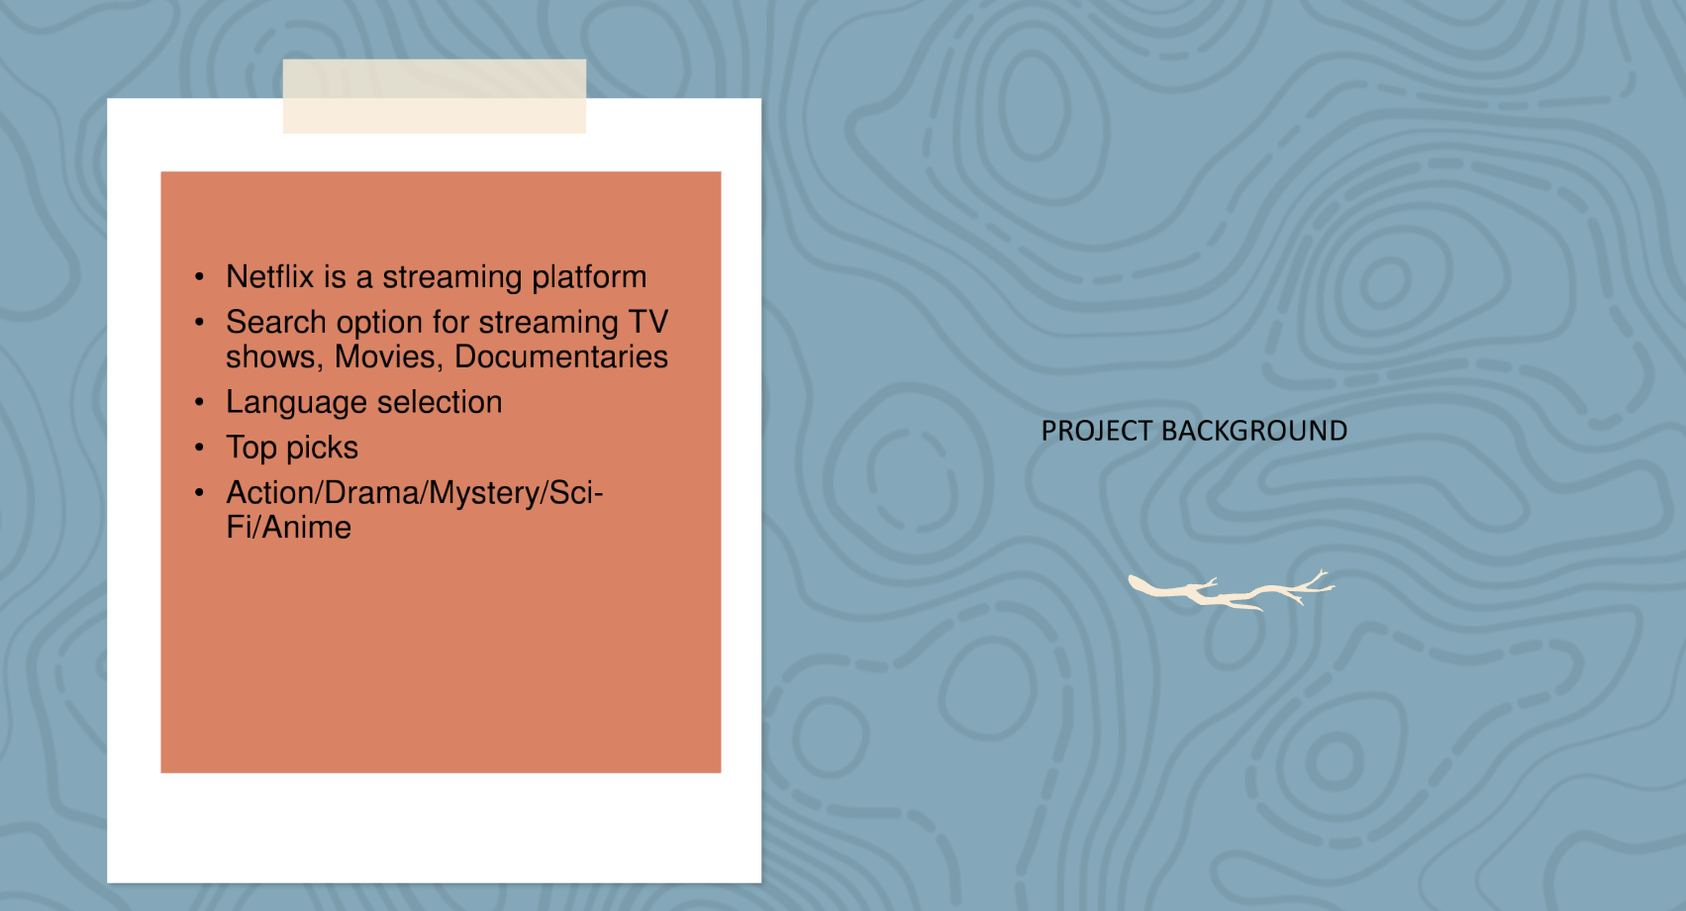
2. PROJECT BACKGROUND
Netflix – Data Analysis
4

Slide 5
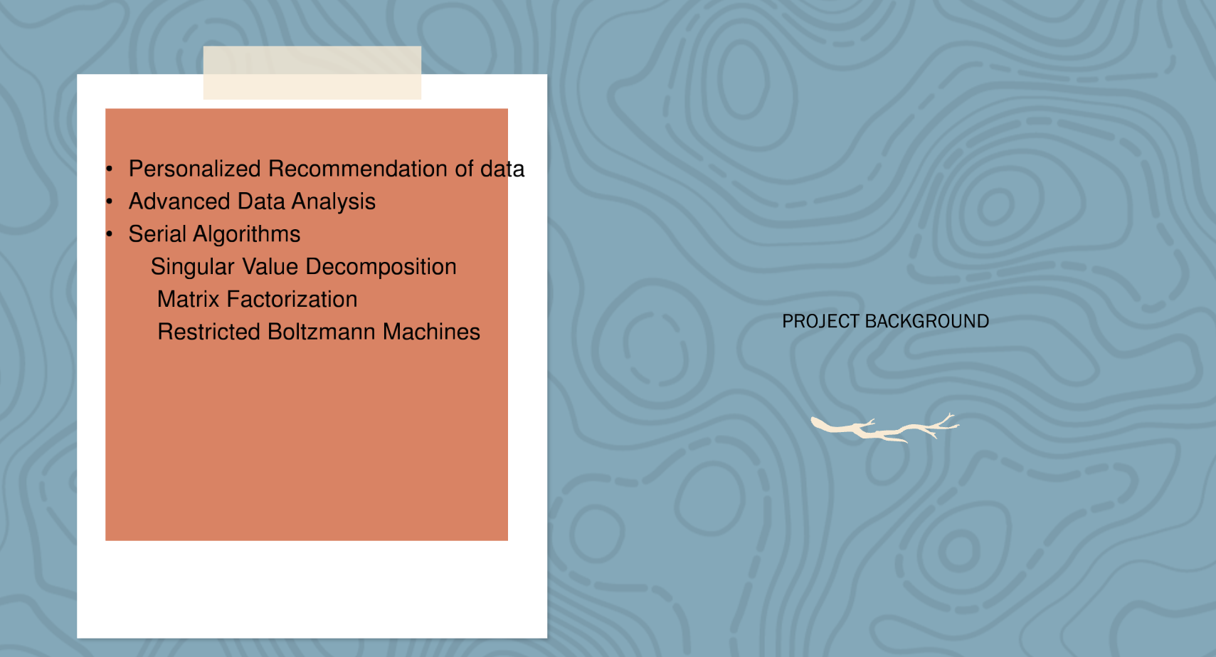
2. PROJECT BACKGROUND
Netflix – Data Analysis
5

Slide 6
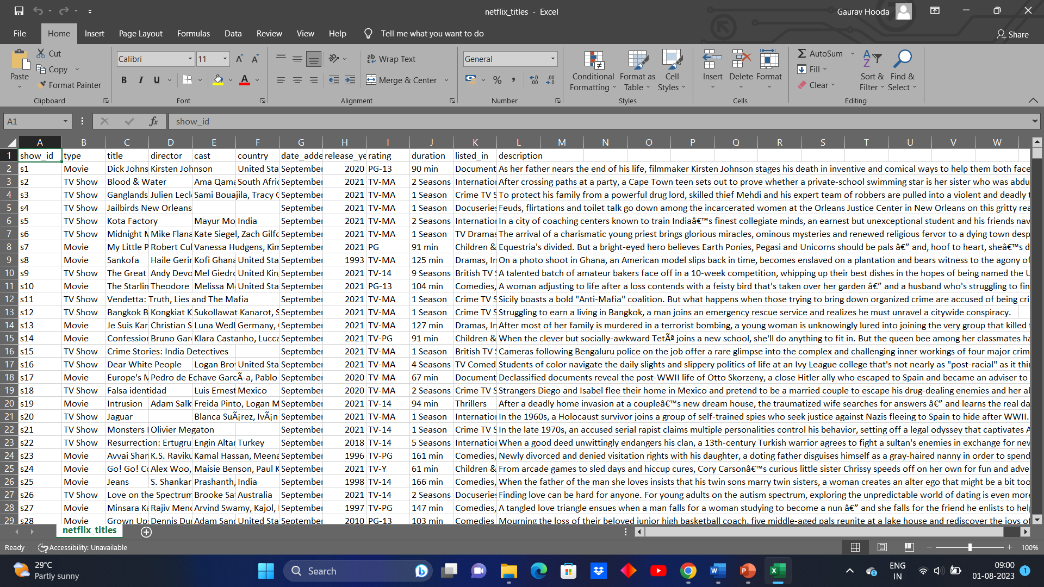
3. DATASETS
Title of project
6

Slide 7
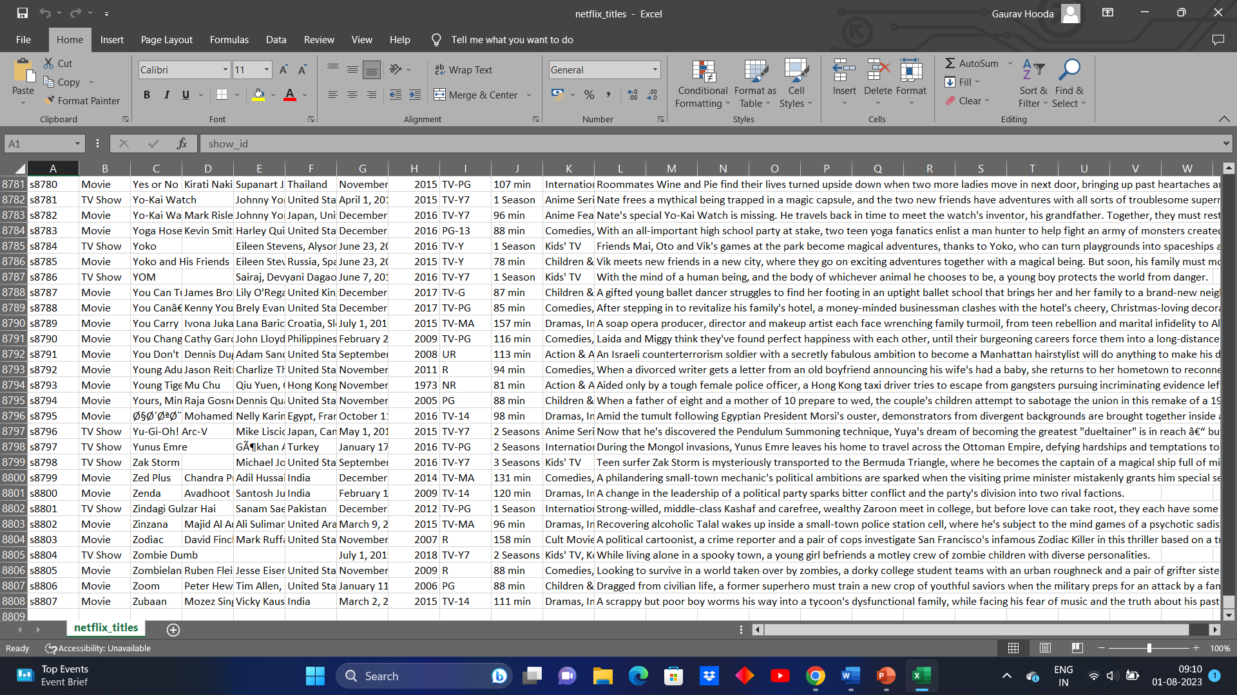
3. DATASETS
Netflix – Data Analysis
7

Slide 8
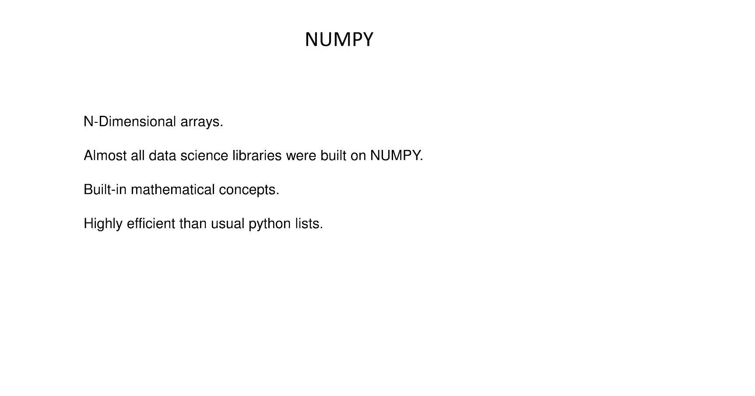
4. METHODS USED
Netflix – Data Analysis
8

Slide 9
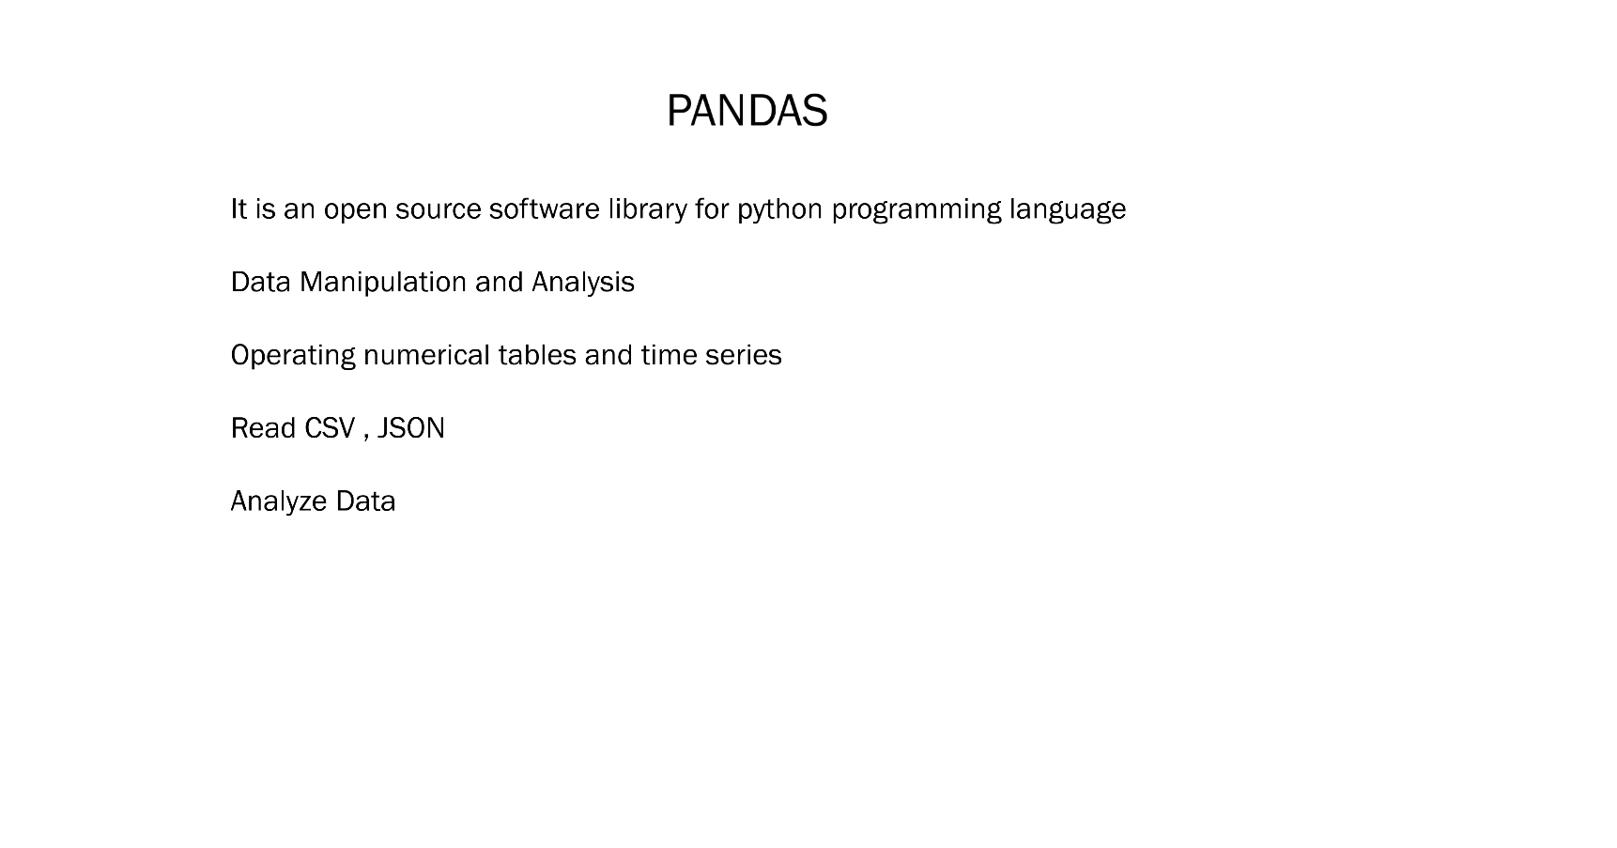
4. METHODS USED
Netflix – Data Analysis
9

Slide 10
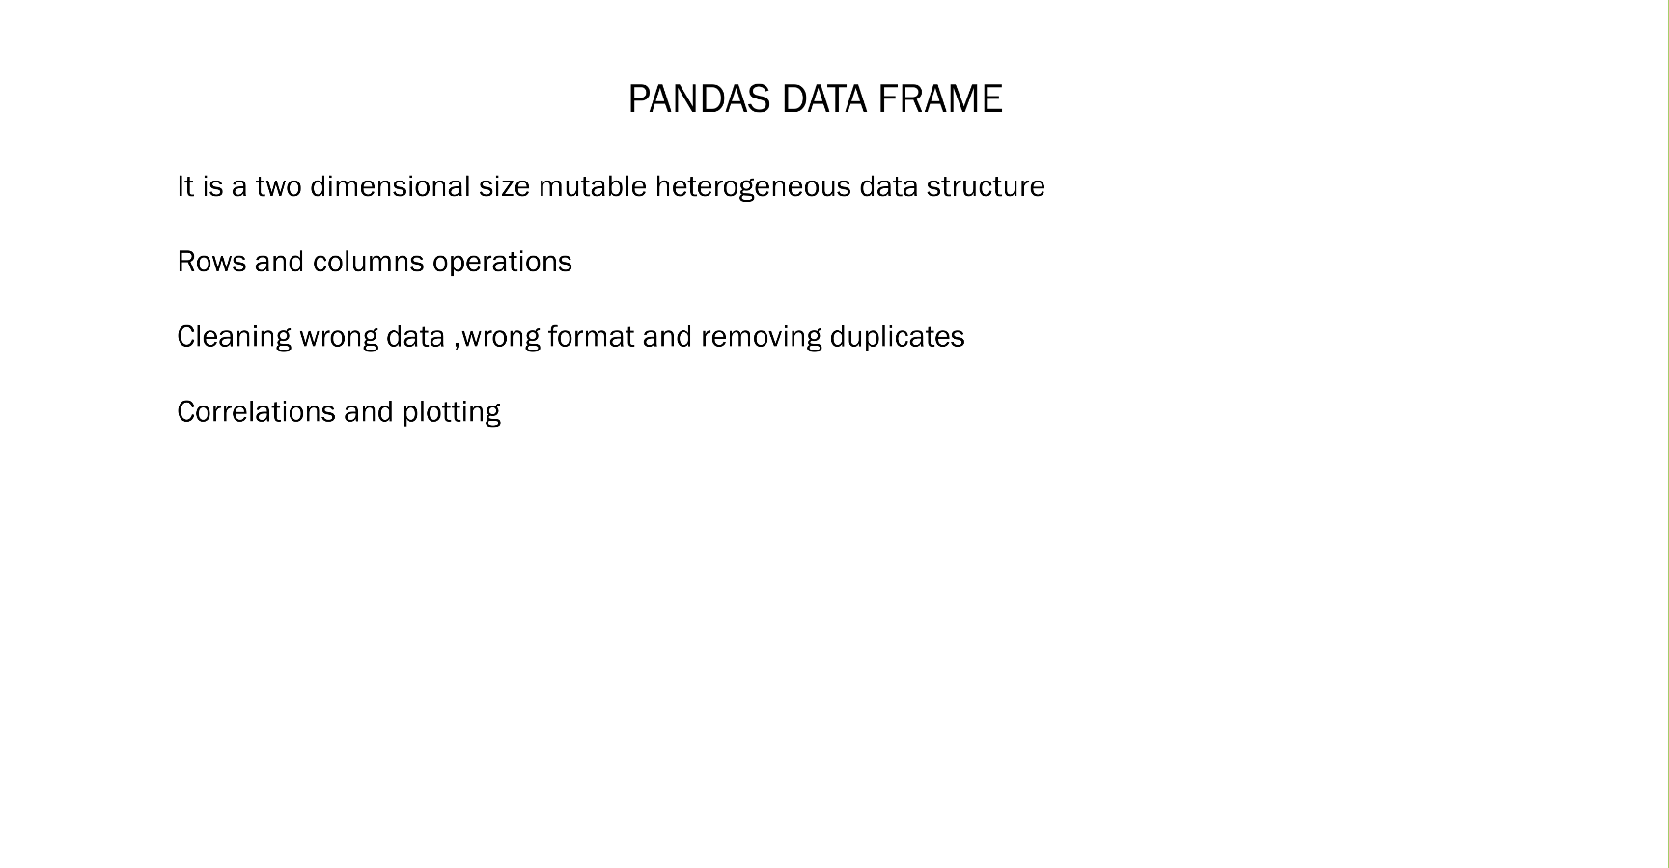
4. METHODS USED
Netflix – Data Analysis
10

Slide 11
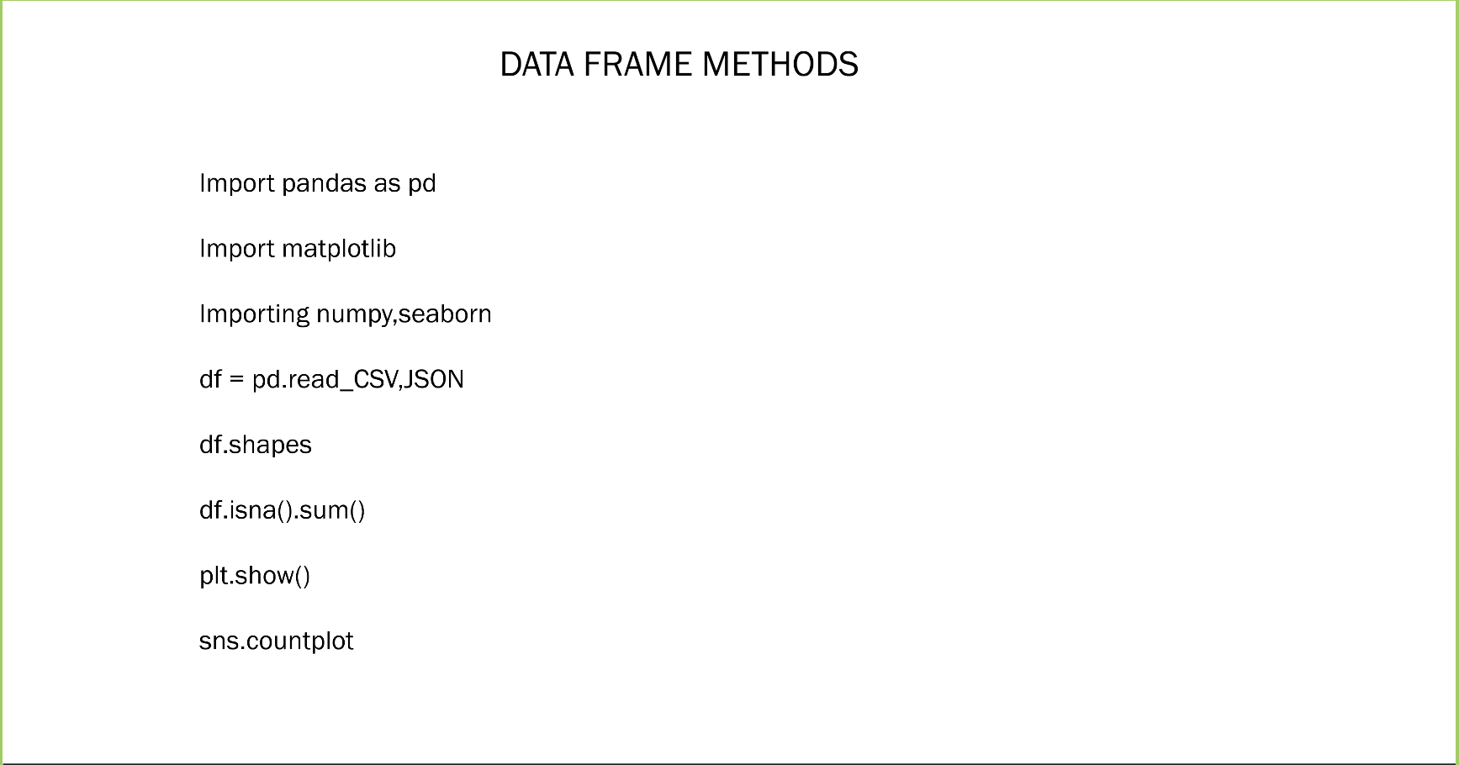
4. METHODS USED
Netflix – Data Analysis
11

Slide 12
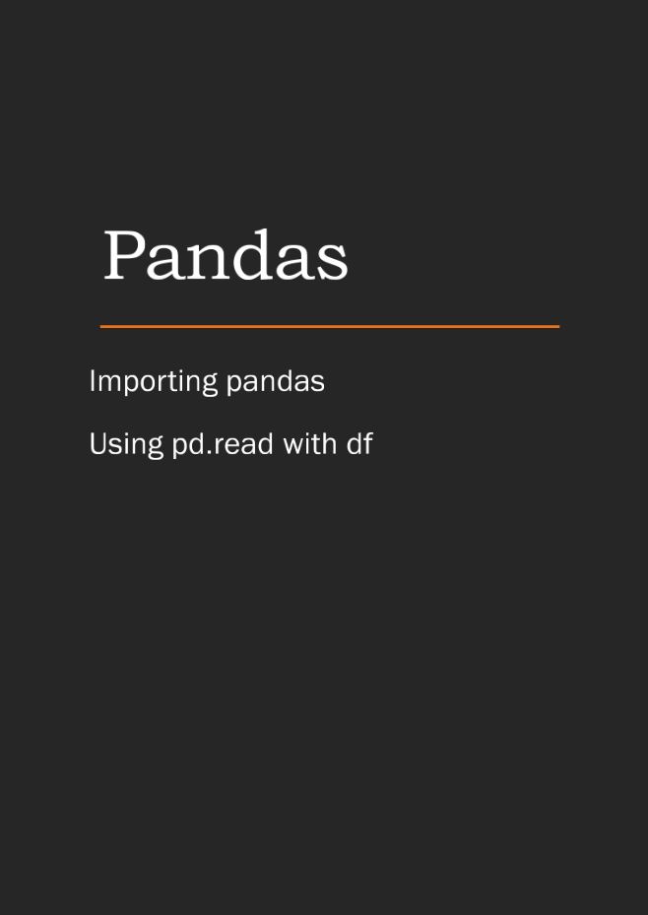
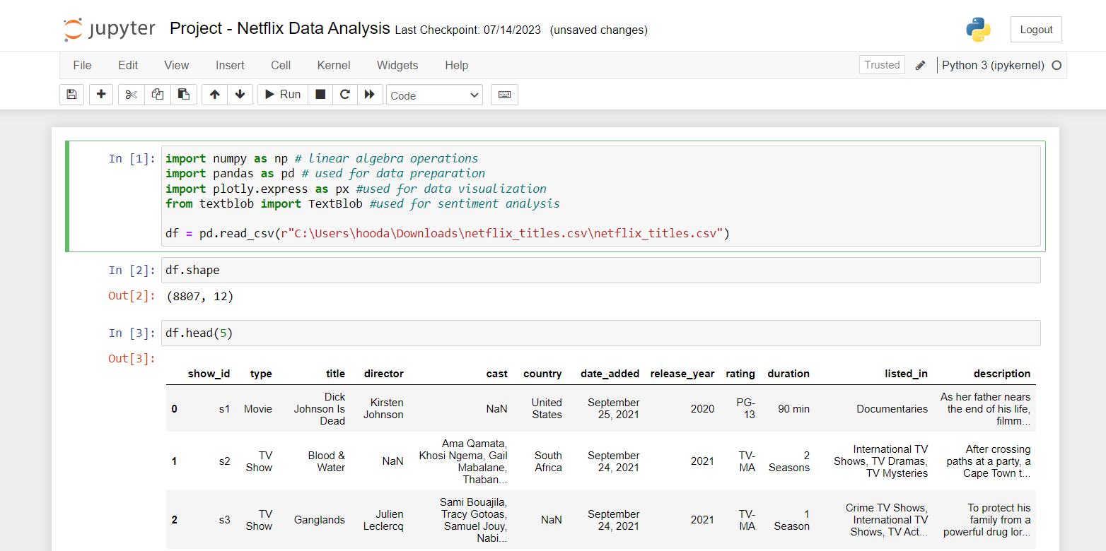
5. RESULTS
Netflix – Data Analysis
12

Slide 13
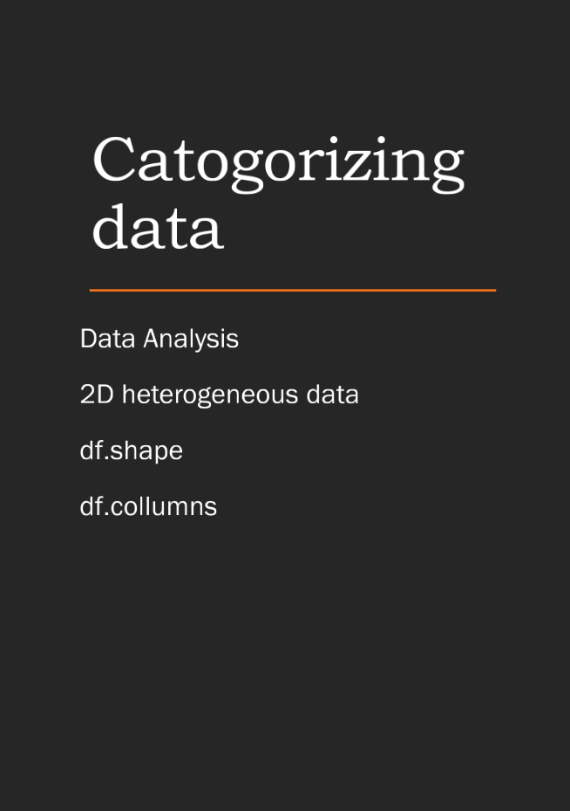
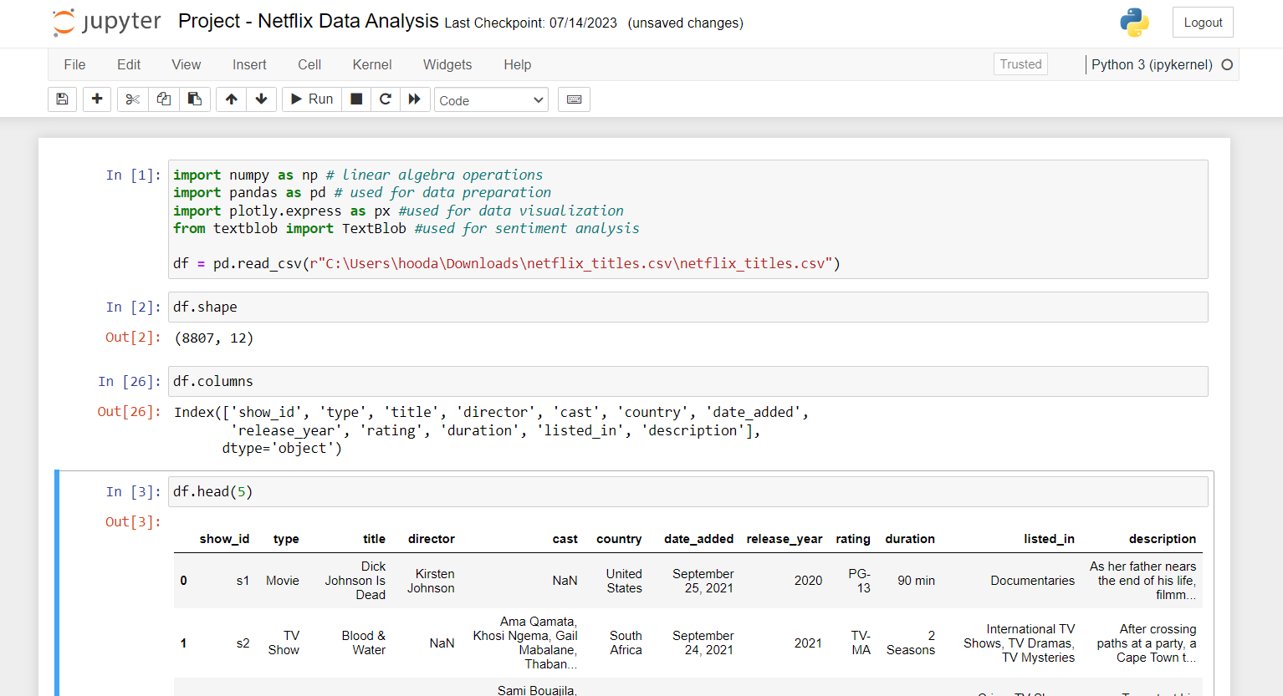
5. RESULTS
Netflix – Data Analysis
13

Slide 14
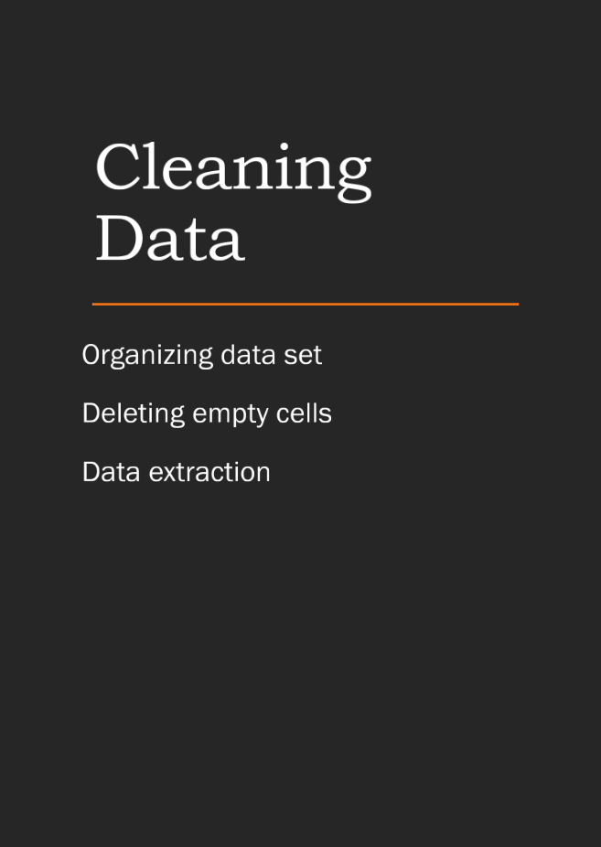
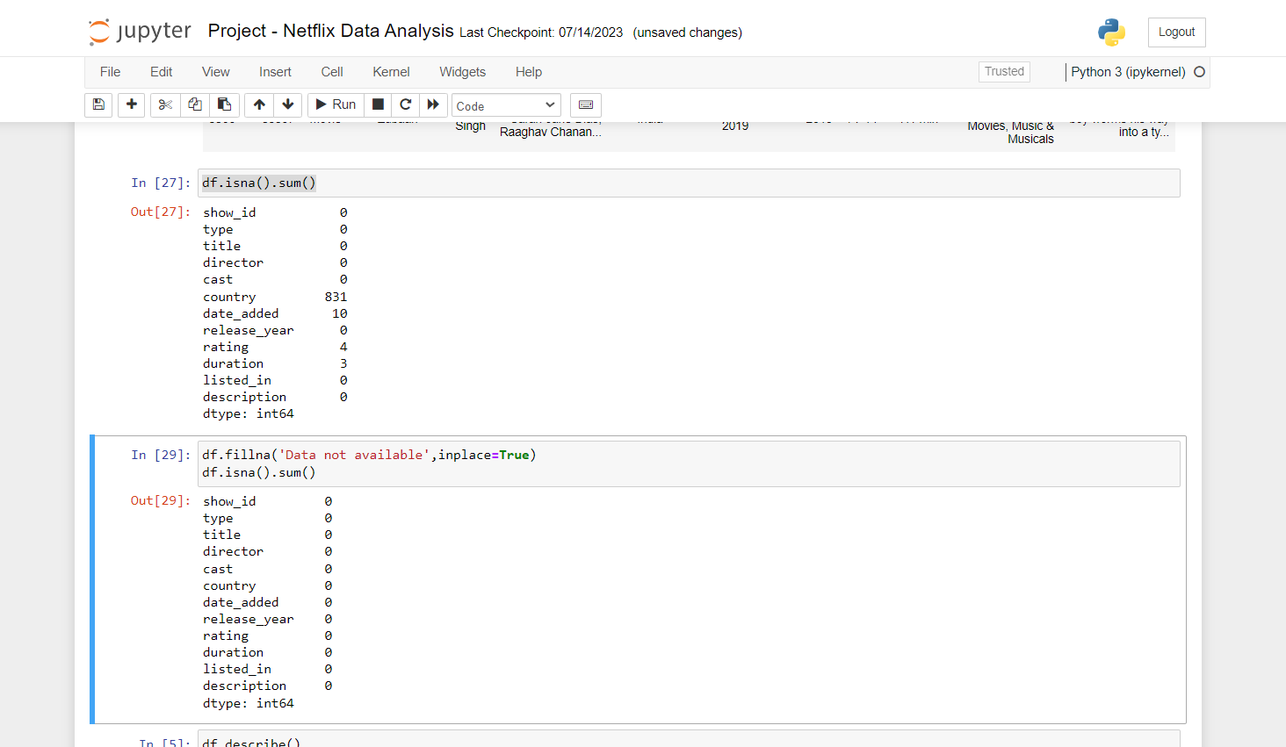
5. RESULTS
Netflix – Data Analysis
14

Slide 15
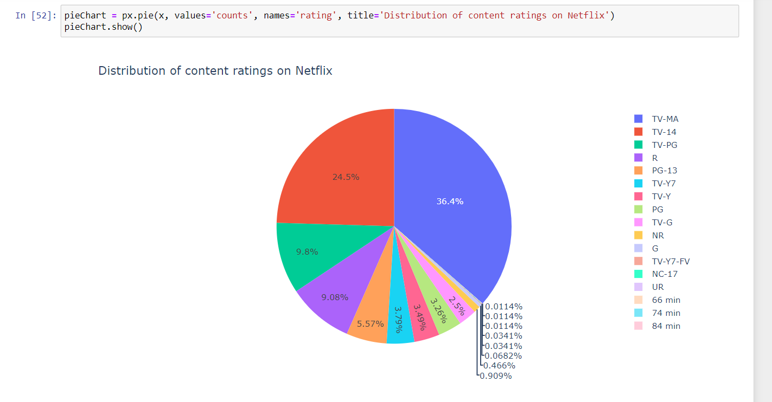
5. RESULTS
Netflix – Data Analysis
15

Slide 16
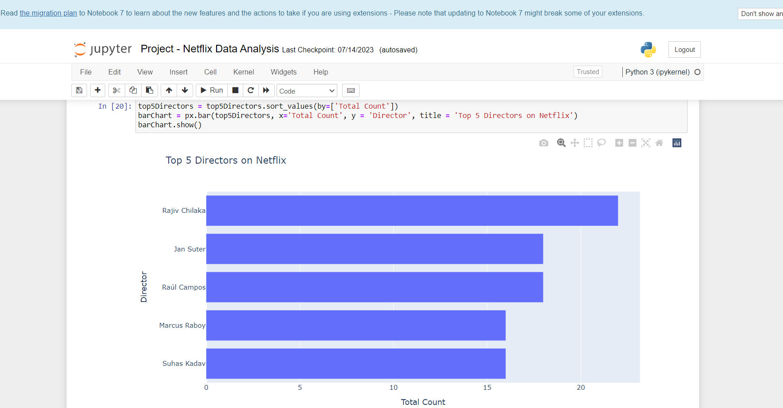
5. RESULTS
Netflix – Data Analysis
16

Slide 17
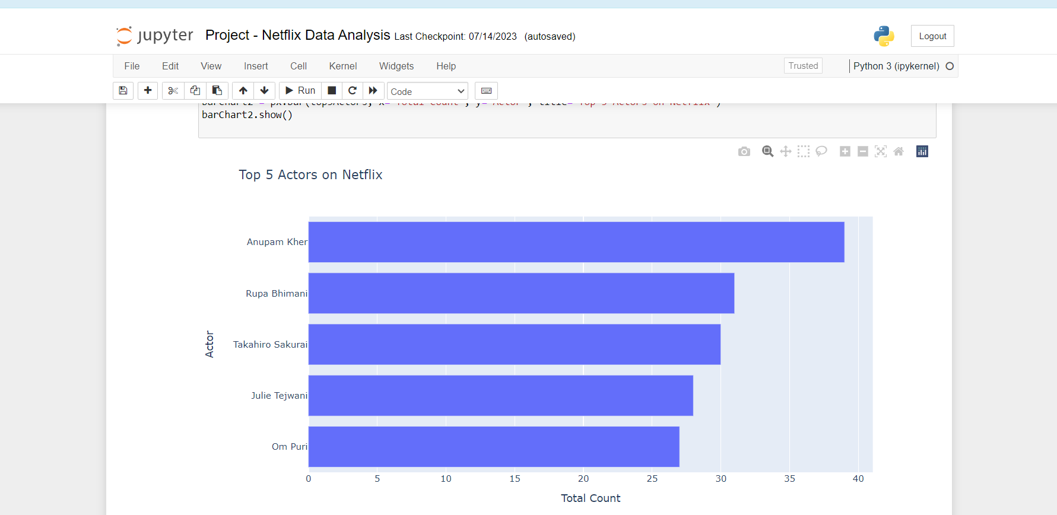
5. RESULTS
Netflix – Data Analysis
17

Slide 18
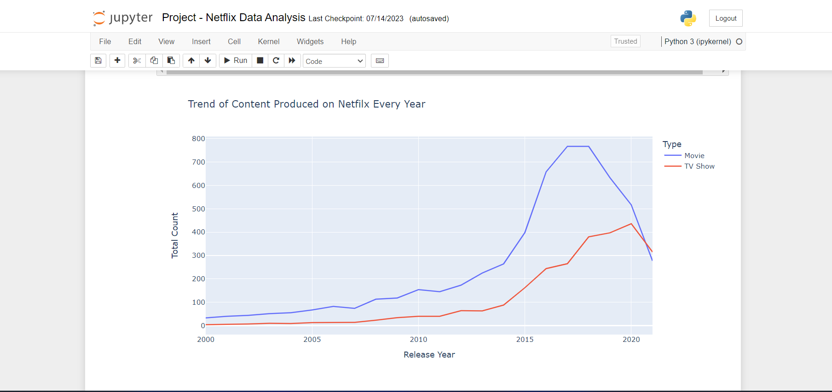
4. RESULTS
Netflix – Data Analysis
18

Slide 19
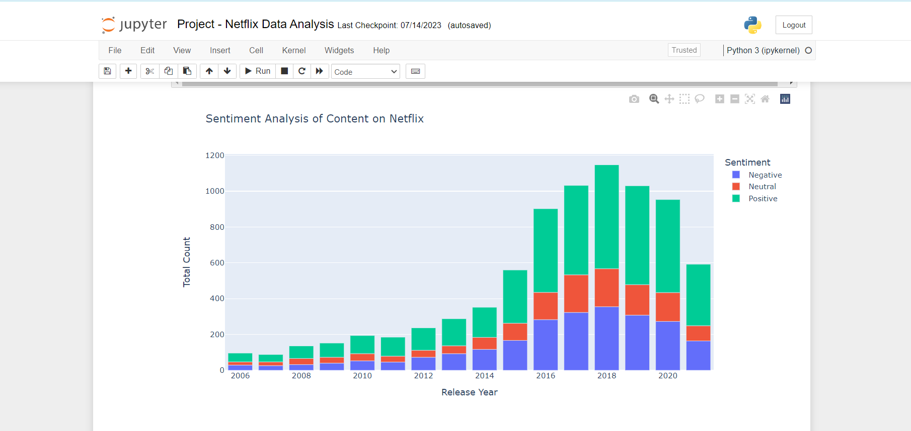
5. RESULTS
Netflix – Data Analysis
19

Slide 20


